Slide 1
Smart Home System
ECE6336-Intro to Architecture of RTOS and IoT

Slide 2
Introduction
A smart home monitoring system uses sensors to detect movement and physiological indicators in order to improve comfort, quality of life, and safety.
We created a password door lock in this project that triggers an alarm if the password is entered incorrectly three times. We also have a temperature sensor that activates a fan when the room becomes too hot, as well as a light sensor that activates the lights when the room becomes dark.

Slide 3
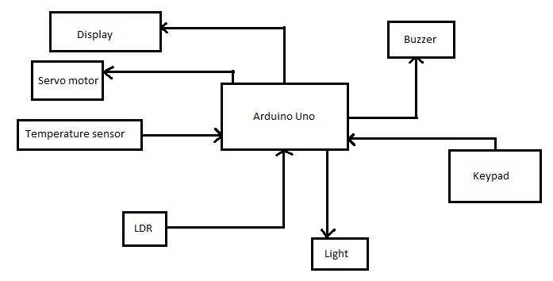
Block Diagram:

Slide 4
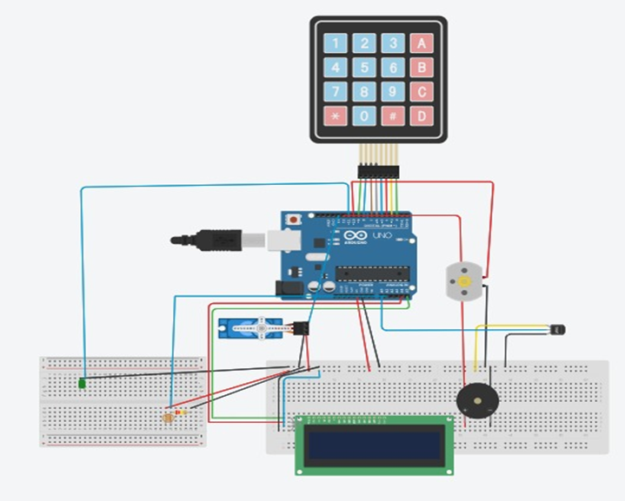
Circuit Diagram

Slide 5
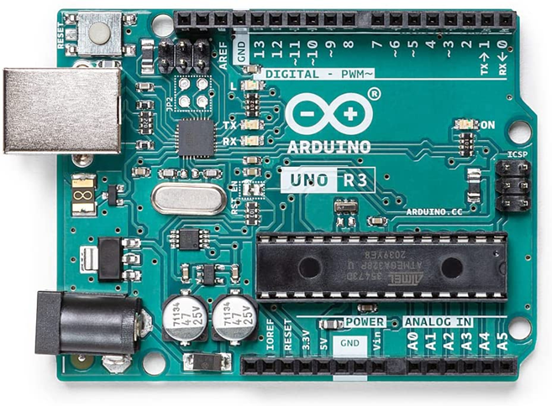
Components:
1)Arduino Uno
Arduino uno is a microcontroller based upon ATmega328P(datasheet). It has 14 digital I/O pins, 6 analog inputs, USB connectivity, power, ICSP headers and reset button.It contains everything needed to support the microcontroller; simply connect it to a computer with a USB cable or power it with a AC-to-DC adapter or battery to get started.

Slide 6
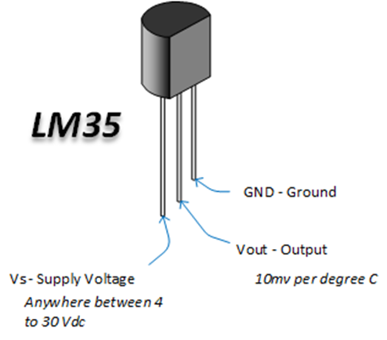
2) Temperature Sensor - LM35
Calibrated Directly in Celsius (Centigrade)
Linear + 10-mV/°C Scale Factor
0.5°C Ensured Accuracy (at 25°C)
Rated for Full −55°C to 150°C Range
Suitable for Remote Applications
Low-Cost Due to Wafer-Level Trimming
Operates From 4 V to 30 V
Less Than 60-μA Current Drain
Low Self-Heating, 0.08°C in Still Air

Slide 7
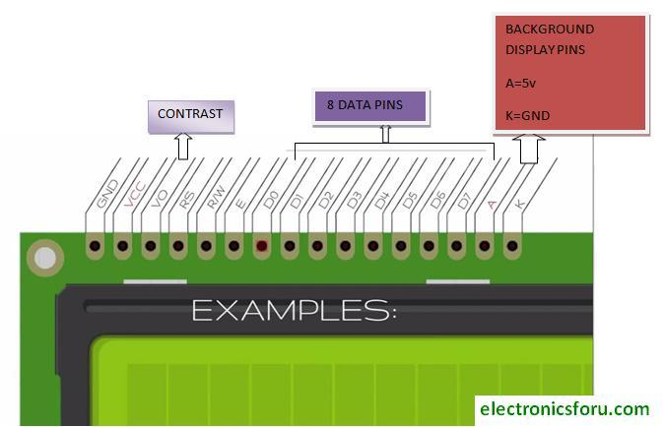
3)LCD Display

Slide 8
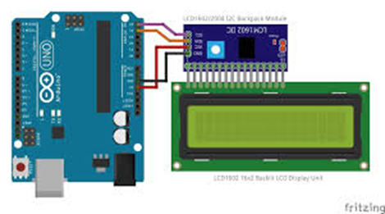
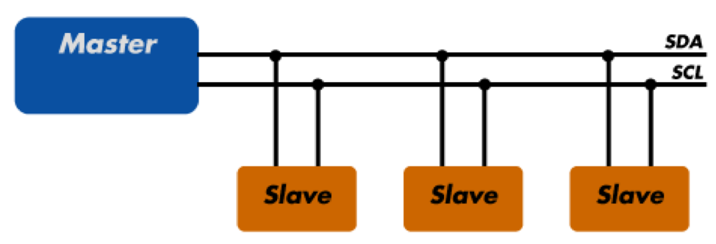
4) I2C Backpack
I2C, or Inter-Integrated Circuit, is a communication protocol often used in embedded systems as a way to transfer data between a master (or multiple masters) and a single slave (or multiple slaves) device. It is a bidirectional two-wire serial bus that uses serial clock (SCL) and serial data (SDA) wires to send and manage data between devices connected to the bus.
Because I2C operates using a serial clock, it considered to be synchronous, which allows the output of bits to be synchronized to the sampling of bits by a clock signal shared between the master and the slave.

Slide 9
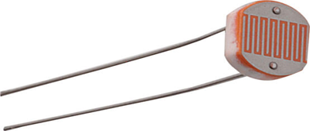
5) LDR
An LDR or photoresistor is a passive component that reduces the resistance of the sensitive surface of the component to receive brightness.
The resistance of a photoresistor decreases with increasing light intensity; in other words, it exhibits photoconductivity. Photoresistors can be used as resistive semiconductors in photodetector circuits as well as in light-activated and dark-activated circuits.
In the dark, a photoresistor can have a resistance of several megaohms (MΩ), while in the light, a photoresistor can have a resistance of only a few hundred ohms.
When the light incident on the photoresistor exceeds a certain frequency, the photons absorbed by the semiconductor give the bound electrons enough energy to jump into the conduction band.
The resulting free electrons conduct electricity, thereby reducing resistance.

Slide 10
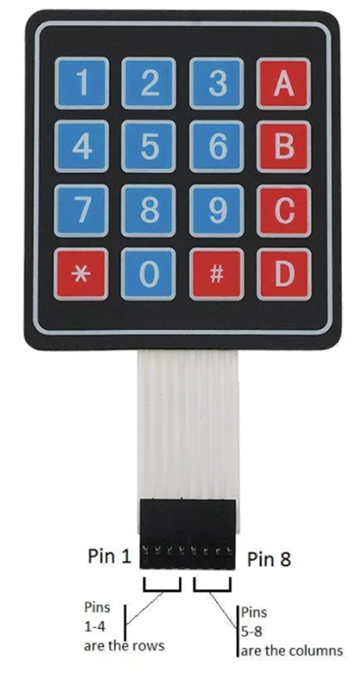
6) 4X4 Matrix Keypad
The 4×4 matrix keypad is an input device that is typically used to provide input values for projects. It features a total of 16 keys, allowing for a total of 16 input values. The most intriguing aspect is that it just required 8 GPIO pins on a microcontroller.
How a microcontroller can read these lines for a button-pressed state :
1.All of the column and row lines are set to input by the microcontroller.
2.The microcontroller then sets the row to LOW.
3.After that, it goes over each column line one by one.
4.The button on the row has not been touched if the column connection remains HIGH.
5.The microcontroller understands which row was set to LOW and which column was detected as LOW when verified whether it goes LOW.
6.Finally, it determines which button corresponds to the detected row and column.

Slide 11
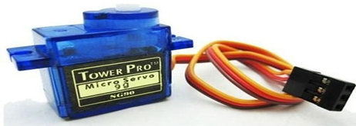
7) Servo motor
A servomotor is a closed-loop servomechanism that controls its motion and ultimate position using position feedback.
A signal representing the output shaft's commanded position is fed into its control.
To provide position and speed feedback, the motor is connected to a position encoder.
Only the position is measured in the most basic scenario. The measured output position is compared to the command position, which is the controller's external input.
If the output position does not match the desired position, an error signal is generated, causing the motor to rotate in either direction to bring the output shaft to the correct position.
The error signal decreases as the positions approach zero, and the motor stops.

Slide 12

Demonstration:

Slide 13
THANK YOU!

